Slide 1
ProfiNET
An Industrial communication standard.
A presentation by Moiz Zaheer Malik, Rubayet Kamal & Mofifoluwa Akinwande

Slide 2
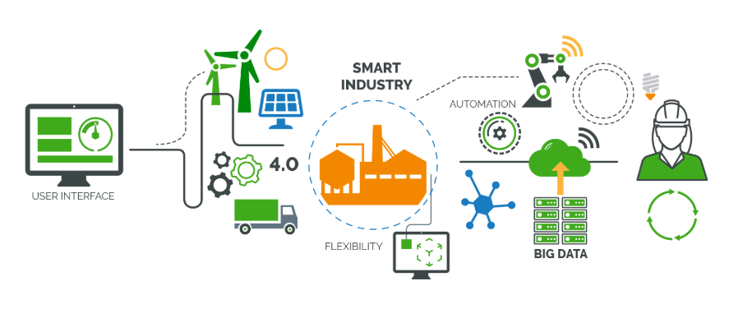
Introduction
[2]

Slide 3

What is ProfiNET?
[1]

Slide 4
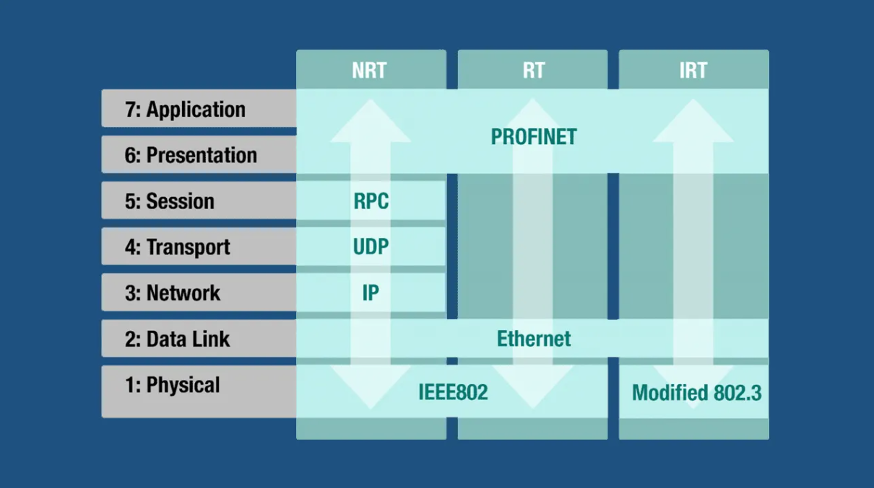
What ís ProfiNET?
[3]

Slide 5
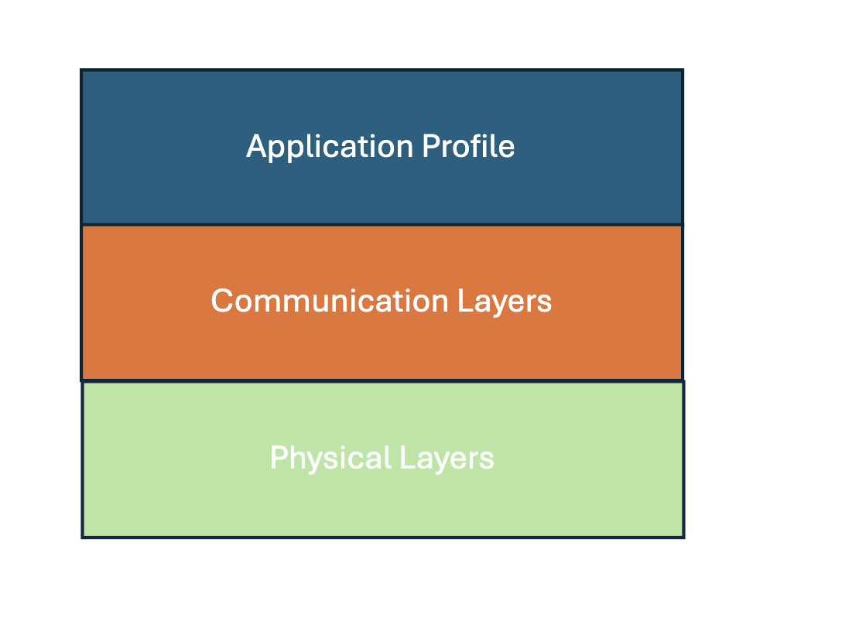
Application Areas
PROFIsafe.
PROFIenergy.
PROFIdrive.
PA Profile.

Slide 6

Application Areas: PROFIsafe
Replaces traditional hardwared safety circuits.
Singe cable to carry both standard and safety data.
International Standard (IEC 61784-3-3) [13].
[7]

Slide 7

Application Areas: PROFIenergy
Standardized interface for energy management.
Eliminates need for additional hardware.
Use Case Example: Unscheduled stops.
Meets ISO 50001 energy efficiency standards [12].
[6]

Slide 8

Comparison: vs Ethernet/IP
Both widely used communication standards
Ethernet/IP commonly used in the United states, ProfiNET in Europe.
[8]

Slide 9

Comparison: vs EtherCAT
Both skip some layers in the OSI model
EtherCAT can communicate with multiple devices in one cycle.
[9]

Slide 10
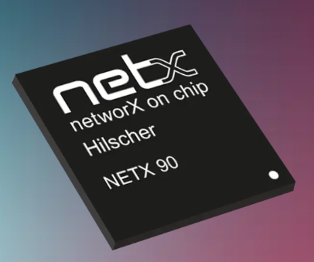
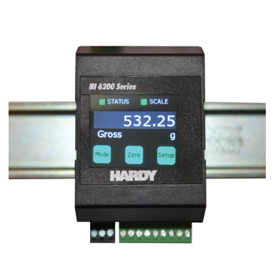
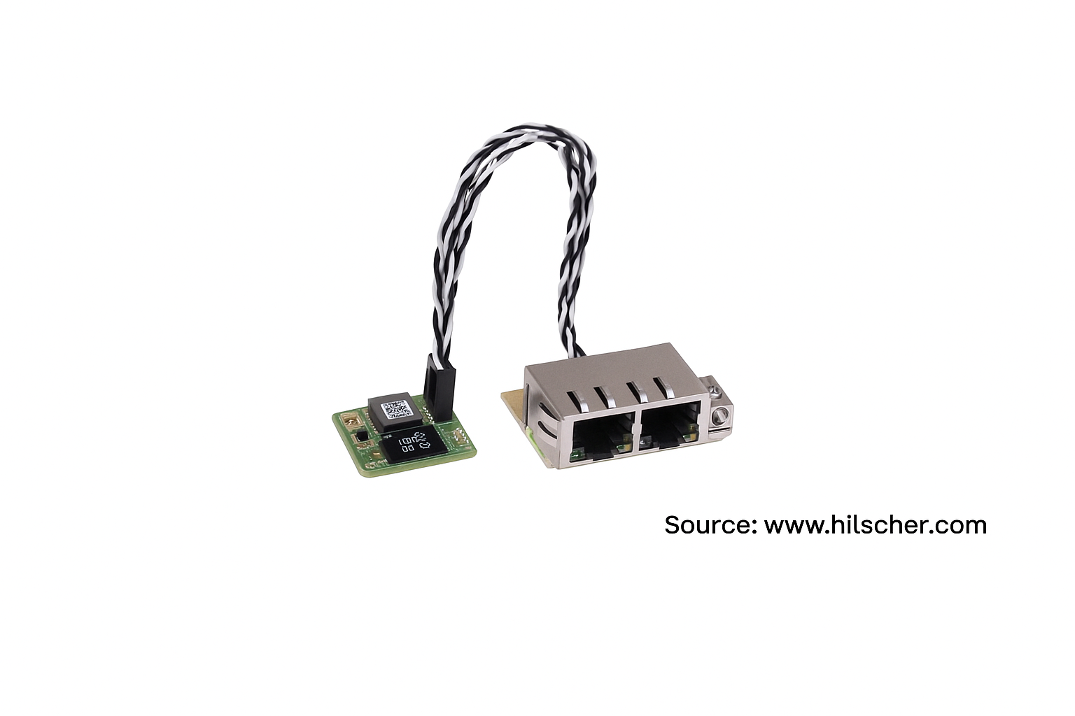
Implementation Example
[11]

Slide 11

Conclusion: TSN? AI?
[10]

Slide 12
References
[1] PI International, “PROFINET – The Backbone of Industrial Communication,” profinet.com. Available: https://www.profinet.com/. [Accessed: Jun. 14, 2025].
[2] Softobotics, “Exploring the Ins and Outs of Industrial Protocols for Industrial IoT,” softobotics.com. Available: https://www.softobotics.com/blogs/exploring-the-ins-and-outs-of-industrial-protocols-for-industrial-iot/. [Accessed: Jun. 14, 2025].
[3] PI North America, “Beginner’s Guide to PROFINET,” us.profinet.com. Available: https://us.profinet.com/beginners-guide-profinet/. [Accessed: Jun. 14, 2025].
[4] IEB Media, “PROFINET over Industrial WLAN Infrastructure,” iebmedia.com. Available: https://iebmedia.com/technology/industrial-ethernet/profinet-over-industrial-wlan-infrastructure/. [Accessed: Jun. 14, 2025].
[5] PI International, “PROFIdrive – Motion Control with PROFINET,” profinet.com. Available: https://www.profinet.com/profinet-explained/profidrive. [Accessed: Jun. 14, 2025].
[6] PROFINET University, “PROFIenergy Profile,” profinetuniversity.com. Available: https://profinetuniversity.com/application-profiles/profienergy-profile/. [Accessed: Jun. 14, 2025].
[7] BROSA GmbH, “PROFIsafe – Safe Communication via PROFINET,” brosa.net. Available: https://www.brosa.net/glossar/profinet-profisafe/. [Accessed: Jun. 14, 2025].
[8] EECO Online, “EtherNet/IP vs PROFINET: The Protocol Heavyweights,” eecoonline.com. Available: https://eecoonline.com/inspire/ethernetip-vs-profinet-the-protocol-heavyweights. [Accessed: Jun. 14, 2025].
[9] CoreTigo, “EtherCAT,” coretigo.com. Available: https://www.coretigo.com/de/glossar/ethercat/. [Accessed: Jun. 14, 2025].
[10] IEB Media, “The Optimal Network Concept for Artificial Intelligence,” iebmedia.com. Available: https://iebmedia.com/technology/tsn/the-optimal-network-concept-for-artificial-intelligence/. [Accessed: Jun. 14, 2025].
[11] Hilscher Gesellschaft für Systemautomation mbH, “netX 90 – Multiprotocol SoCs,” hilscher.com. Available: https://www.hilscher.com/products/multiprotocol-socs-stacks/multiprotocol-socs/netx-90. [Accessed: Jun. 14, 2025].
[12] PROFINET. PROFIenergy. Accessed: 2025-06-10. 2025. URL: https : / / www.profinet.com/profinet-explained/profienergy.
[13] PROFINET. PROFIsafe. Accessed: 2025-06-10. 2025. URL: https : / / www.profinet.com/profinet-explained/profisafe

